Slide 1
New. Pacman
Presented by 0652087 戴勵揚

Slide 2
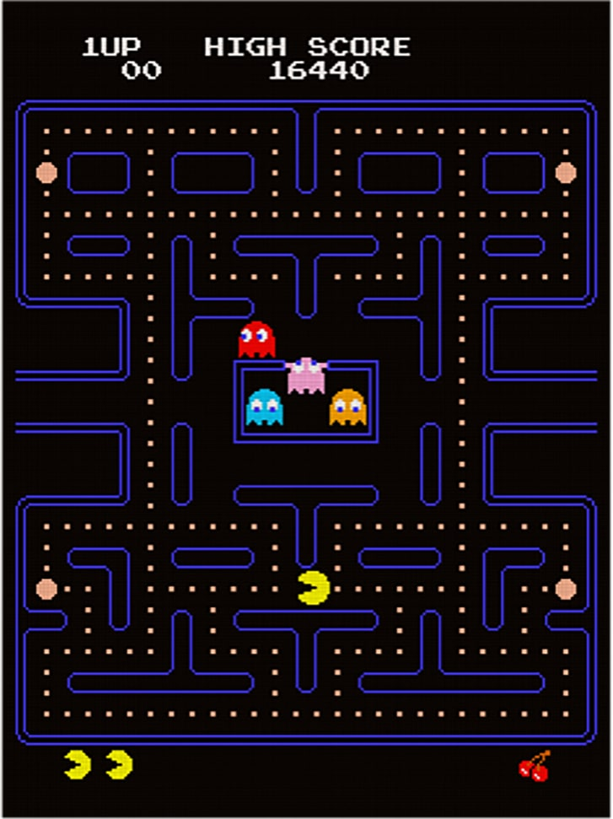




Specification
UI: Start Button / Game Interface
Process: Pacman auto-plays

Slide 3
Rules
Pacman needs to eat all the dots and avoid the ghosts.

Slide 4
DQN
States: Pacman Position, Ghost Position, Dot Position, Map
Action: Up, Down, Left, Right
Bellman Equation: NewQ(s,a) = Q(s,a)+α[R(s,a)+γmaxQ’(s’,a’)-Q(s,a)]
Q = model.predict(state0)
Qnew = R + γ*max(Q(state1))
Loss Function: loss = (Qnew – Q)^2
Learning rate
Discount Rate
Mean Squared Error

Slide 5
Flow Chart
Start
State of Game
Caught by Ghost
Game Continue
DQN
Action
Game Over

Slide 6
Breakdown
Pacman
Pygame
DQN
Environment
Punishment
Reward
State
Caught by Ghosts/Loss Game
Maze
Ghosts
Pacman (Player)
Dots
Grid
Location of All Agents
Input Action: Up, Down, Left, Right
Eat Dots/Eat Ghost

Slide 7
MSC
Player
Colab
Pygame
DQN
Execute
Run Code
Open
Return Visual
Initialize Game
Await Command
Start
Run Game
Return State
Get State
Call Model
Predict
Measure Reward
Return Action
Get Action
Input Action
Play
Update Q Value
Game Over

Slide 8
API
Name | Pacman
Input | Up, Dwn, Left, Right (Action)
Output | Position, State
Name | DQN (Predict)
Input | State (Init Q / After Perform)
Output | Update Q Value (Action)
Name | Ghost, Dots, Map (NPC)
Input | None
Output | Position, State

Slide 9
Evaluation
Execute 10 times and calculate the win percentage.

